Slide 1
How does ChatGPT work?
A leaners perspective (simplified mental map)

Slide 2
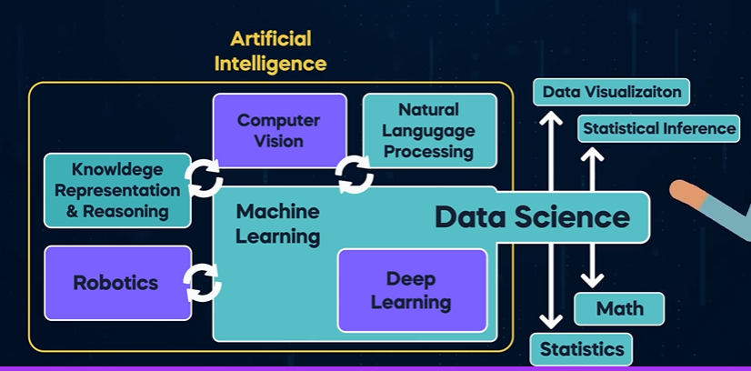

Slide 3
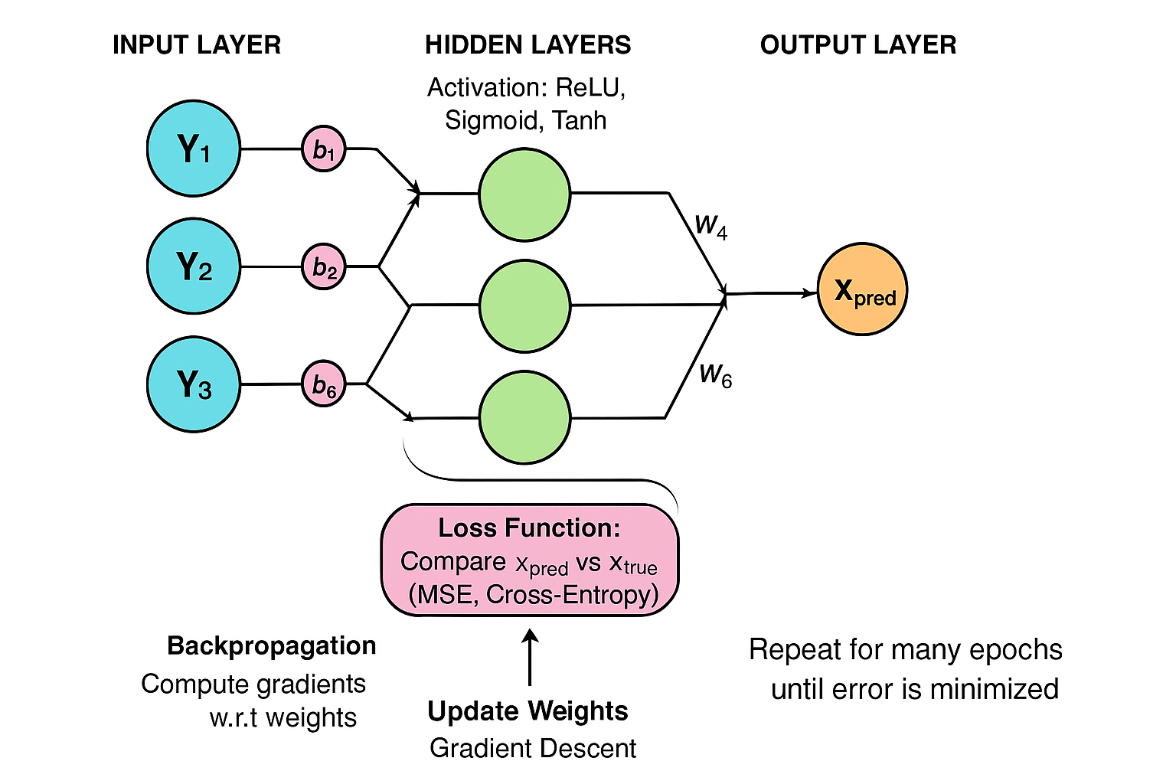
Neural Network

Slide 4
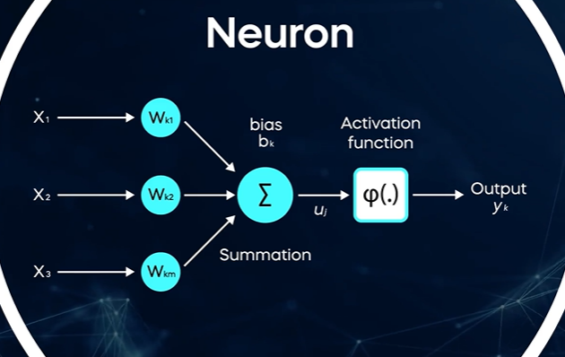
Neural Network

Slide 5
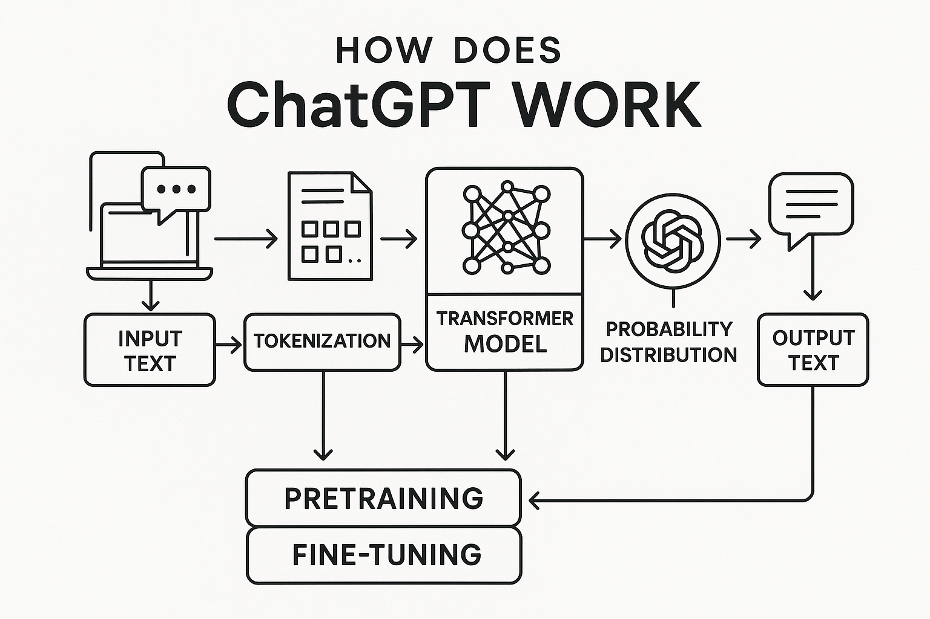
Expose to massive data. Broad learning
Learn specific information like Medical
GPT Generative pre-Trained transformer

Slide 6
Predict the next word in the sequence and loop
Input
Input text e.g. “What is the capital of India?”
Output
Output: “What is the capital of India?” The
Output
Output: “What is the capital of India?” The capital
Output
Output: “What is the capital of India?” The capital of
Output
Output: “What is the capital of India?” The capital of India
Output
Output: “What is the capital of India?” The capital of India is
Output
Output: “What is the capital of India?” The capital of India is New
Output
Output: “What is the capital of India?” The capital of India is New Delhi

Slide 7
Step 1: Tokenisation and Embeddings
Input text e.g. “What is the capital of India?” is broken down into constituent units called Tokens e.g. “What”, “is”, “the”, “capital”, “of”, “India”, “?”
Token → [“What”, “is”, “the”, “capital”, “of”, “India”, “?”]
Token ID → [123,12,343,4543,45,5656,10]
English vocab has 50,257 tokens (this differs widely for every model/version)
we can turn each word into a one-hot encoding vector of size 50257, where only the dimension at index i (the word's value) is 1, and all others are 0.

Slide 8









Step 1: Tokenisation and Embeddings
ChatGPT accepts 2048 length queries.
A vector of [1,2,…. 2048] tokens. If query is shorter then elements are left blank.
Given English vocab has 50257 tokens,
This can be represented as 2048 X 50257 Matrix of 1s and 0s.
Each element can only be 1 or zero, representing the input tokens.
Notes:
https://tool.lu/fr_FR/article/5cv/preview

Slide 9
Step 1: Tokenisation and Embeddings
Through pre-training using neural networks, each of the 50257 Token is linked to another token in 12,288 dimension (embedding matrix)
Represented as a 50,257 X 12,288 matrix
Our earlier input matrix 2048 X 50257 is multiplied to above 50,257 X 12,288 matrix
This results into a smaller 2048 X 12288 matrix
So now we have knowledge of all the tokens in user input and how each of those tokens relate to other tokens in vocabulary.
No reasoning, no context-mixing has happened yet.
Notes:
https://tool.lu/fr_FR/article/5cv/preview

Slide 10
Step 1: Tokenisation and Embeddings
Token relationships represented in 12,288 dimension as the embedding matrix is learned during training
During pretraining, the model sees huge amounts of text and learns embeddings by backpropagation:
Forward pass:
Each token ID is mapped to its row in E (the embedding vector).
These vectors go through the Transformer layers and produce predictions for the next token.
Loss computation:
The predicted token distribution is compared to the actual next token using cross-entropy loss.
Backward pass:
Gradients flow back from the loss all the way to the embedding matrix.
Each row in E gets updated only for tokens that were actually used in that batch (sparse update).
Notes:
https://tool.lu/fr_FR/article/5cv/preview

Slide 11
Step 1: Tokenisation and Embeddings
Input Vector = Token embedding (what we saw earlier)
+ Positional encoding
Token embeddings tell the model what word you have. Positional encodings tell the model where the word is in the sentence. The Transformer layers then mix “what” + “where” to understand meaning in context.
Positional encoding is also a 2048 X 12,288, where for each Position (1 to 2048), during training, the model learns what kind of position info is most useful.
e.g. position[5] = [0.23, 0.45, 0.5,…… ] (a 12,288 vector)
Notes:
https://tool.lu/fr_FR/article/5cv/preview

Slide 12
Step 1: Tokenisation and Embeddings (Summary)
Tokenization & Embedding:
The input text is first tokenized into tokens (subwords or words).
Each token ID is converted into a dense vector by looking up an embedding matrix.
This produces a sequence of embeddings: a matrix of shape [seq_len, embedding_dim].
Positional Encoding Added:
Since Transformers don't inherently understand order, a positional encoding vector (or embedding) is added to each token embedding to inject information about token position.
The resulting vectors (token embedding + positional encoding) become the input embeddings to the first Transformer layer.
Input to the Transformer Layer:
This sequence of vectors ([seq_len, embedding_dim]) goes into the first Transformer layer.
For subsequent layers, the input is the output from the previous Transformer layer, of the same shape.
Notes:
https://tool.lu/fr_FR/article/5cv/preview

Slide 13
Step 1: Tokenisation and Embeddings (Summary)
At this point, “bank” in “river bank” means same as in “bank account”
No reasoning, no context-mixing has happened yet.
Notes:
https://tool.lu/fr_FR/article/5cv/preview

Slide 14
Step 2: The Transformer network (the real brain)
ChatGPT runs embeddings them through dozens of Transformer layers or blocks (e.g., GPT-4 ~96 layers).
Each Transformer layer has:
Self-attention → lets tokens exchange information and “see” each other’s context.
Feed-forward network (MLP) → does nonlinear transformations to detect higher-level patterns.
Layer norms, residuals → keep training stable. This stage is where:“I love cats” turns into an understanding that “cats” is an object of “love”. The network decides which context words are important for predicting the next token.
Notes:
https://tool.lu/fr_FR/article/5cv/preview

Slide 15
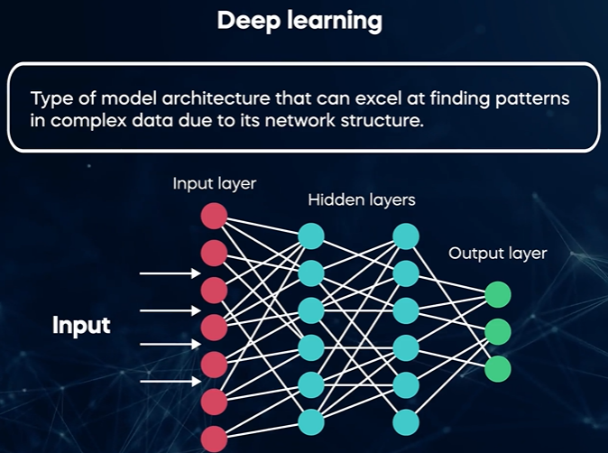
Step 2: The Transformer network (the real brain)
A type of neural network developed by Google Brain in 2017
Transformers are subset of deep learning (RNN being another subset)
They pay ‘attention’ to specific words
Contextual understanding
Text or Images
Notes:
RNNs recurrent nn are generally sequential and could loose the context for longer inputs

Slide 16
Step 2: The Transformer network (the real brain)
A type of neural network developed by Google Brain in 2017
Transformers are subset of deep learning
Text or Images
Notes:
https://tool.lu/fr_FR/article/5cv/preview

Slide 17
Step 2: The Transformer network (the real brain)
Each word looks at other words and describe how important they are for its meaning
To answer, “what is the capital of India”, model must connect “capital” – “India”
This is what “Attention” does
Multi-head : Different perspectives of relationship (grammar, meaning, long-range connections)
Notes:
https://tool.lu/fr_FR/article/5cv/preview

Slide 18
Step 2: The Transformer network (the real brain)
Feed forward network (FFN)
Inside each transformer layer
Input → Multi-Head Attention → Add & Norm → Feed Forward → Add & Norm → Output
Attention decides what information each token should collect.
FFN decides how to mix, transform, and represent that information.
Example:
Attention might enrich the token “capital” with context from “India”.
FFN then transforms that enriched vector into a representation that makes it easier for later layers to predict “Delhi”.
Notes:
https://tool.lu/fr_FR/article/5cv/preview

Slide 19
Step 2: The Transformer network (the real brain)
Token vector (with position info)
│
▼
Multi-Head Attention
│ (tokens attend to each other)
▼
Residual Connection + LayerNorm
│
▼
Feed Forward Network
│ (nonlinear transformation per token)
▼
Residual Connection + LayerNorm
│
▼
Output of this Transformer block
This output is the input to the next Transformer block. So, if GPT-4 has ~96 layers, this process repeats 96 times, each time refining the representation.
Notes:
https://tool.lu/fr_FR/article/5cv/preview

Slide 20
Step 3: Output logits → softmax → next token
The last Transformer layer produces a hidden vector for each token position.
This is projected back to vocab size via the same embedding matrix (weight tying).
Softmax turns scores (logits) into a probability distribution over all possible next tokens.
Model picks the next token (“Delhi”), either greedily (highest probability) or via sampling/temperature for creativity.
Delhi: 0.92
Mumbai: 0.05
Paris: 0.001
...
Notes:
https://tool.lu/fr_FR/article/5cv/preview

Slide 21
Step 4: Autoregressive generation
Model picks the next token (highest probability or via sampling).
That chosen token is appended to the sequence.
The whole sequence goes back into the Transformer.
Process repeats until an end-of-text token is generated or max length reached.
Notes:
https://tool.lu/fr_FR/article/5cv/preview

Slide 22
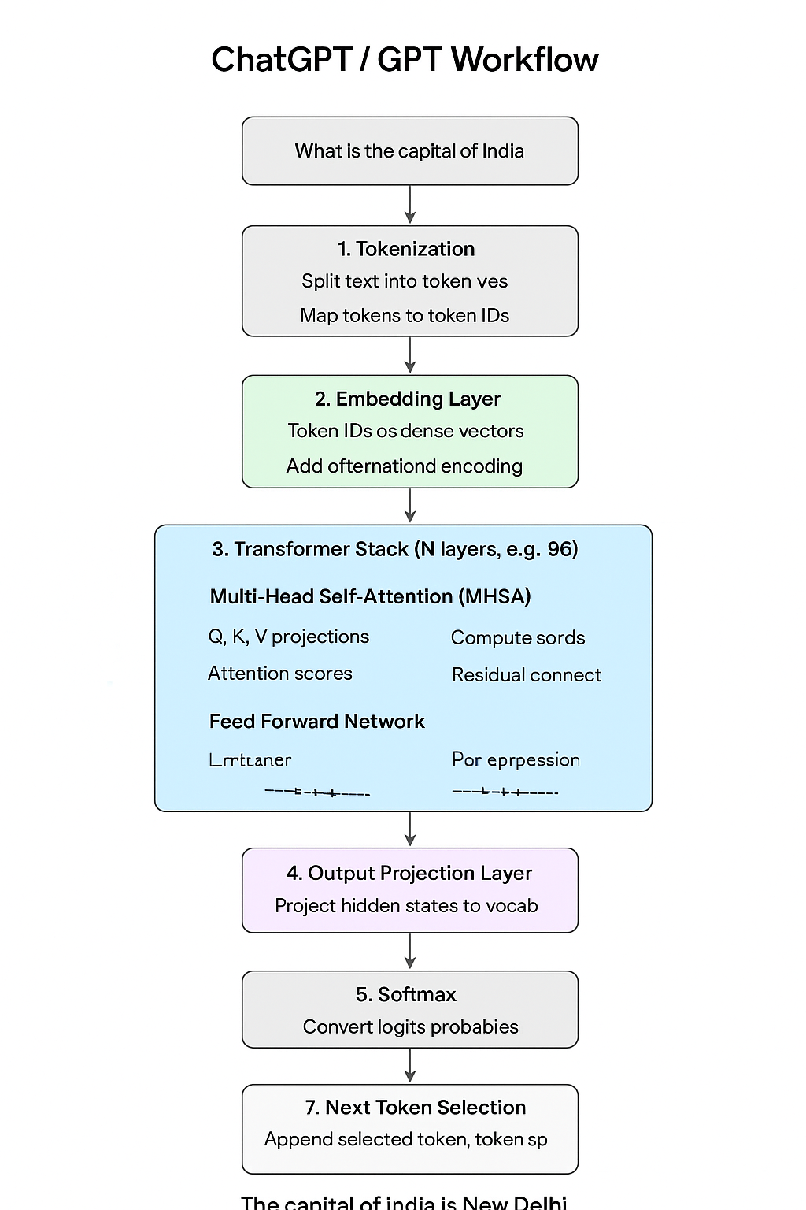

Slide 23
Language Models
Probabilistically predicts optimal word to fill the blank space:
Masked - guess the missing word regardless of its position in the sentence
Autoregressive language models - predicts next word like ChatGPT
Statistically learning from vast amount of data

